Slide 1
IP Headroom
AWS Security Group exhaustion

Slide 2
Background
Security Groups (SGs) need for internet traffic in/out of AWS
SGs are attached to subnets (IP address ranges) to channel traffic
Typically subnets created as small segments of a larger CIDR range
You are probably familiar with Class C size subnets, like:
192.168.0.0/24
That would provide 254 IP addresses from
192.168.0.1 - 192.168.0.255

Slide 3
Background
Subnets are purpose built as small slices of a larger IP space
This allow segregation of traffic among security Zones
This is GOOD

Slide 4
Background - Scaling
Scaling is Key to effective Cloud usage.
When Traffic is HIGH: Scale UP!
When Traffic is Low: Scale DOWN!
Why? Saves lots of Money

Slide 5
Problem
Scaling Up requires available IPs
Running out of IPs in your Subnet is BAD
Services don’t scale
Sites fail
Traffic slows
Sales missed
Transactions lost
Customers complain, then worry

Slide 6
Solution
Know how many IPs are available in your Subnet
Know roughly how much you will need to scale
2x?
10x?
50x?
100?
Make sure you have enough room for your peek (and some extra)

Slide 7
Gather your Subnet Info
Straight from AWS APIs
Pull in to a data Set
Analyze Subnet Size, Current Usage, Available Space

Slide 8
IP Headroom
Evaluate Subnets
How much “Headroom” do we have?
Report on anything below the targeted peak
Fix it now (before we scale)

Slide 9
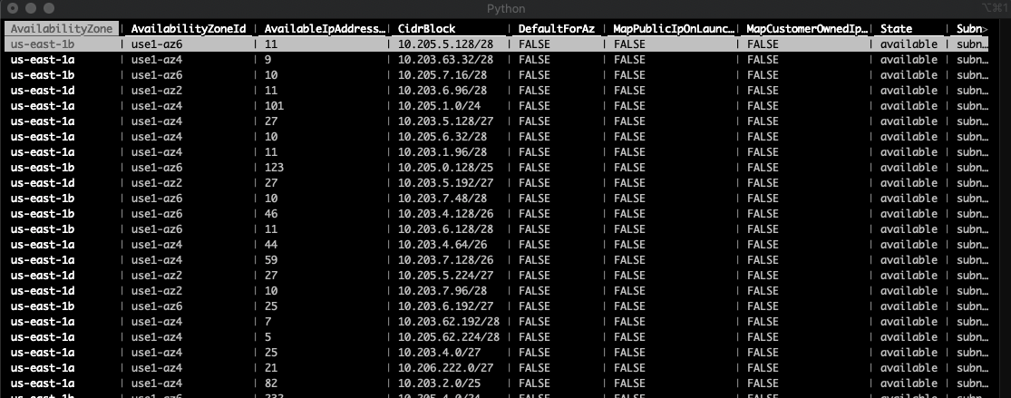
Data Set - subnets.csv

Slide 10
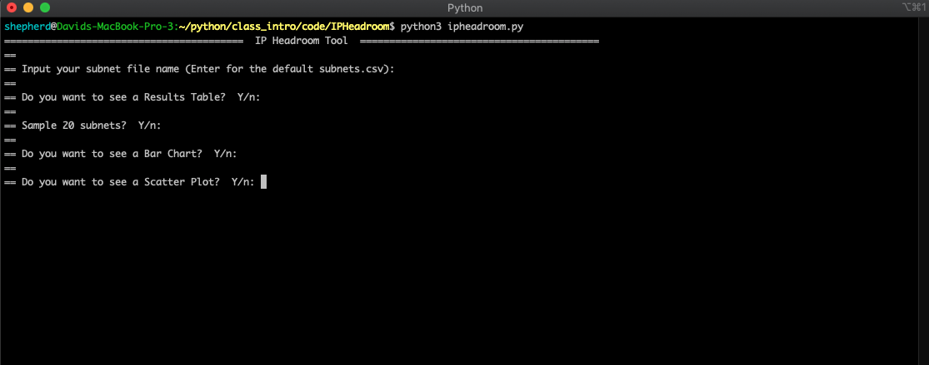
Setting up Evaluation

Slide 11
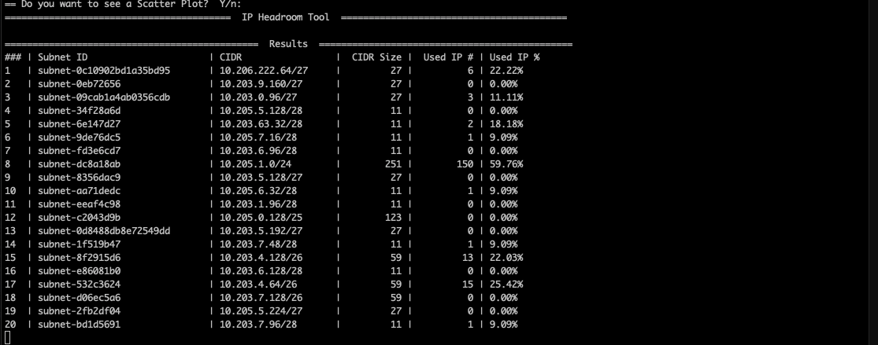
Data Table of Results

Slide 12
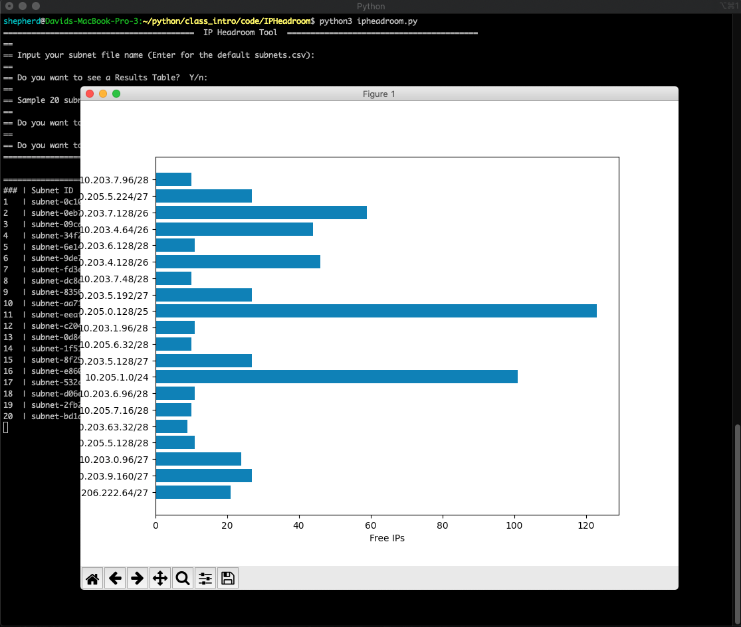
Horizontal Bar Chart

Slide 13
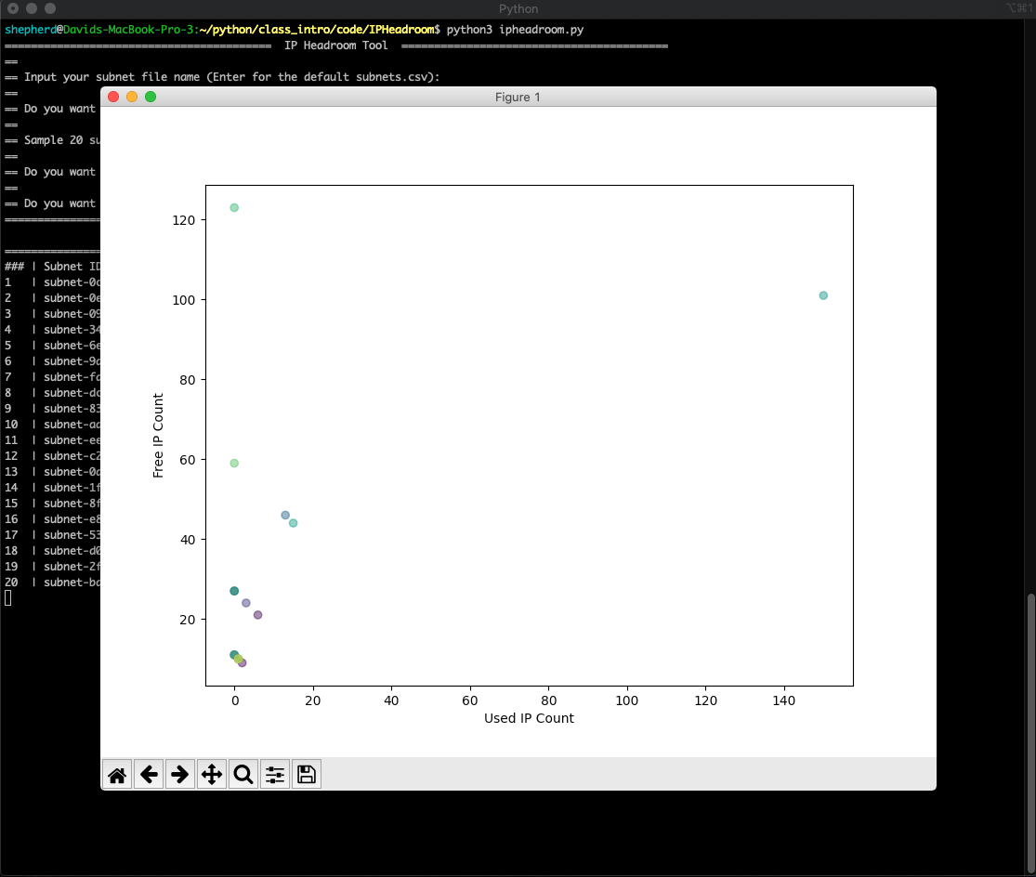
Scatter Plot

